Slide 1
ANAND ENGINEERING COLLEGE AGRA
Computer Science and Engineering
PRESENTATION ON
BIG DATA
By :
RINSHITA
CSE 3rd YEAR

Slide 2
Introduction
Nowadays, we do mostly heard about Big Data, everyone is talking about it as the upcoming future of the world.
Simply, Big Data is similar to small data but bigger in size.
Everyday, we all store data in different devices (hardware, mobile phones) etc.
In the previous years the storage capacity of first computers was only one Gigabyte.
Today we can store our data in Terabytes.
Millions of organisations are generating the data in Petabytes everyday.
The whole world including us, combinedly is generating 3-4 Exabytes (equals 3-4 million terabytes or 30-40 lack terabytes)everyday.
All this is nothing in front of BIG DATA.

Slide 3
What is BIG DATA (Comparison With Rice)
BYTE
(a small grain of rice)
KILOBYTE
(a cup of rice)
MEGABYTE
(8 bags of rice)
GIGABYTE
(3 semi trucks of rice)
TERABYTE
(2 container ships of rice)

Slide 4
What is BIG DATA (Comparison With Area)
PETABYTE
(covers Himachal Pradesh)
ZETTABYTE
(fills the pacific ocean)
YOTTABYTE
(an Earth size rice ball)
THE FUTURE
EXABYTE
( covers Uttar Pradesh 3 times )

Slide 5
MICROCOMPUTERS
(BYTE and KB)
DESKTOP
(MB and GB)
INTERNET
(TB and PB)

Slide 6
EXABYTE
AND
ZETTABYTE
3,607,080
Searches Every minute
4,146,600 users watch videos every minute
4,166,667 users generate likes in every minute
BIG DATA
Exabyte= 1000 000 000 000 000 000 bytes

Slide 7
Big Data is a term that describe voluminous volume of data- both structured and unstructured data that is difficult to process using traditional database processors and software techniques.
Big Data requires different tools and architecture to analyze the data computationally and to reveal the behavior, interaction, trends, patterns etc. all over the world.

Slide 8
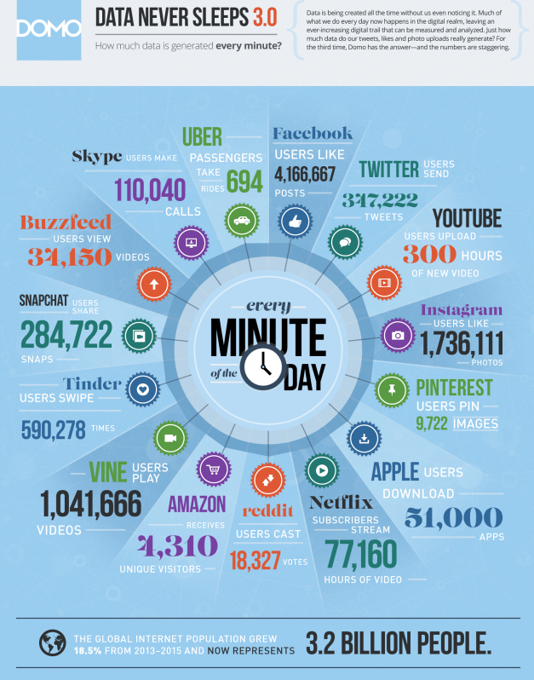
Why BIG DATA
Aim to solve new problems or old problems in a better way.
Availability of data
Increase of storage capacities
Increase of storage power
Firms like Google, Facebook, LinkedIn, Instagram, eBay, WhatsApp etc, are generating voluminous data everyday.

Slide 9
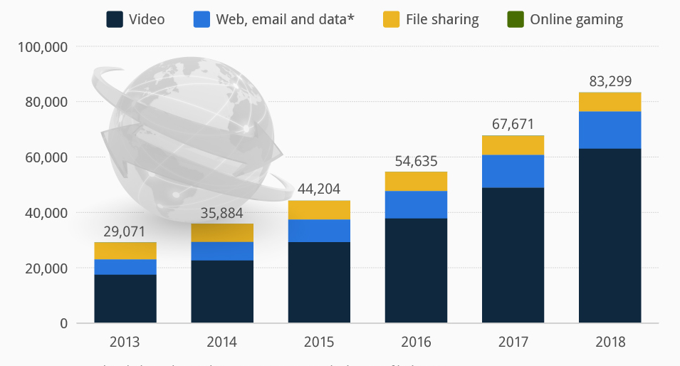
Why BIG DATA
Increased in consumer traffic.
Organizations need to process this raw information.
Big Data provides facility.
It generates values from storage of digital information.
Determining root causes of failures, issues and defects in near-real time.
Recalculating entire risk portfolios in minutes.
Detecting fraudulent behavior before it affects your organization.
Big data can be analyzed for insights that lead to better decisions and strategic business moves.

Slide 10

Applications Of BIG DATA
Trading Analytics
Finance
Manufacturing
Traffic Control
Cyber Security
Smart Healthcare
Telecom

Slide 11
Three Characteristics of BIG DATA ( 3Vs )
VOLUME
Analyse data quantity
VELOCITY
Analyse data speed
VARIETY
Analyse data types
(at which rate the data is generated)
(how much data is generated)
(which variety of data is generated)

Slide 12
VOLUME
The quantity of generated and stored data. The size of the data determines the value and potential insight- and whether it can be considered big data or not.
The quantity of generated and stored data. The size of the data determines the value and potential insight- and whether it can be considered big data or not.
Facebook has 2 billion users, YouTube 1 billion users, Twitter 350 million users and Instagram 700 million users. Every day, these users contribute to billions of images, posts, videos, tweets, flight data etc.
Organizations collect data from a variety of sources, including business transactions, social media and information from sensor or machine-to-machine data. In the past, storing it would’ve been a problem – but new technologies (such as Hadoop) have eased the burden.

Slide 13
VELOCITY
In this context, the speed at which the data is generated and processed to meet the demands and challenges that lie in the path of growth and development.
It analyzes clickstreams and capture Ad impressions with user behavior at millions of events per second
Analyzes high-frequency stock trading algorithms reflect market changes within microseconds.
Data streams in at an unprecedented speed and must be dealt with in a timely manner. RFID tags, sensors and smart metering are driving the need to deal with torrents of data in near-real time.

Slide 14
VARIETY
The type and nature of the data. This helps people who analyze it to effectively use the resulting insight.
Traditional database systems were designed to address smaller volumes of structured data, fewer updates with consistent data structure.
Big Data analysis includes different types of data– from structured, numeric data in traditional databases to unstructured text documents, email, video, audio, stock ticker data and financial transactions.

Slide 15
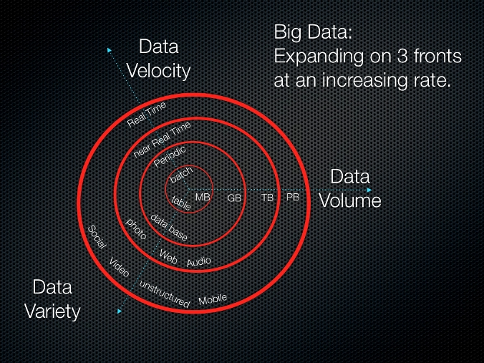
Illustration Of 3Vs

Slide 16
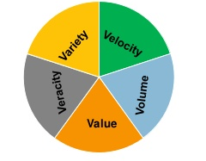
Other Characteristics Of Big Data
Veracity
Variability
Analyses data quality of captured data
(data affecting accurate analysis)
Analyses inconsistent data
(includes processes to handle and manage it)

Slide 17
VERACITY
In Big Data Veracity refers to the biases, noise and abnormality in data.
Is the data that is being stored, and mined meaningful to the problem being analyzed?
Veracity is the biggest challenge when compares to things like volume and velocity. Scoping out Big Data strategy includes to keep the data and processors ‘clean’ and preventing the accumulation of ‘dirty data’ in the systems.

Slide 18
VARIABILITY
Variability refers to the inconsistent data.
In addition to the increasing velocities and varieties of data, data flows can be highly inconsistent with periodic peaks.
Inconsistency of the data set can hamper processes to handle and manage it.
Daily, seasonal and event-triggered peak data loads can be challenging to manage. Even more so with unstructured data.

Slide 19
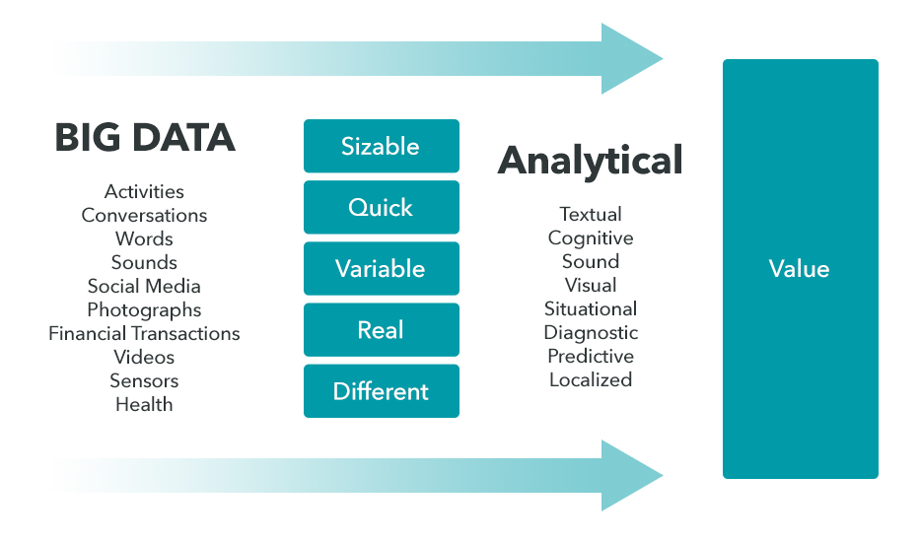
Turning Big Data into Value

Slide 20
Risks Of BIG DATA
RISKS
Security Challenge
Cost Escalate Too Fast
Outdated Analytics
Information Overload
Cyber Breach
Unorganized
siloed data

Slide 21
India- BIG DATA
Indian government is using geospatial analytics for deeper understanding of urbanization, but the use of big data is not new.
The big data metrics also allowed the economists to get a sense of labor flows throughout the country.
The government also used big data analytics to get an estimate of trade in the country.
Moreover, the Indian government is also planning to use big data and analytics information available on corporate houses and individuals for income tax assessments.
The government will start collecting statistics from usual sources like banks as well as online transactions and social media sites to match the spending and lifestyle patterns of a citizen with income declarations.
National Data Sharing and Accessibility Policy (NDSAP) 2012 of DST is designed to promote data sharing and enable access to government owned data.

Slide 22
Benefits Of BIG DATA
Cost Savings : Some tools of Big Data l1ike Hadoop and Cloud-Based Analytics can bring cost advantages to business when large amounts of data are to be stored and these tools also help in identifying more efficient ways of doing business.
Time Reductions :The high speed of tools like Hadoop and in-memory analytics can easily identify new sources of data which helps businesses analyzing data immediately and make quick decisions based on the learnings.
New Product Development : By knowing the trends of customer needs and satisfaction through analytics you can create products according to the wants of customers.
Understand the market conditions : By analyzing big data you can get a better understanding of current market conditions. For example, by analyzing customers’ purchasing behaviors, a company can find out the products that are sold the most and produce products according to this trend. By this, it can get ahead of its competitors.
Control online reputation: Big data tools can do sentiment analysis. Therefore, you can get feedback about who is saying what about your company. If you want to monitor and improve the online presence of your business, then, big data tools can help in all this.

Slide 23
SAS- Hadoop
With Hadoop, understanding what your data has to tell you can be challenging. SAS makes it easy to understand. With SAS, you can:
Interactively explore billions of rows of data in seconds. Visually examine Hadoop data quickly. Look at both structured and unstructured data – like Twitter feeds – to discover when and why your customers' behavior changes.
Put fast, powerful analytics in the hands of all users. Easy-to-use analytics helps even those with limited technical skills interact with and analyze data on their own.
Tell others. Whether it's through the web, mobile devices or Microsoft Office applications, you can easily share your findings. Pass it along.

Slide 24
VISUAL ANALYTICS
Interactive reporting. Visual discovery. Self-service analytics. Scalability and governance. All from a single, powerful in-memory environment.
Create stunning interactive reports and dashboards. Quickly summarize key performance metrics, and share them via the web and mobile devices. Executives and frontline staff can quickly interact with and collaborate on insights, slice and dice it to find their own answers, and better understand business performance.
Visually explore critical drivers for making better decisions. Find out why something happened. Examine all options and uncover opportunities hidden deep in your data. Automatically highlight key relationships, outliers, clusters and more, revealing vital insights that inspire action.

Slide 25
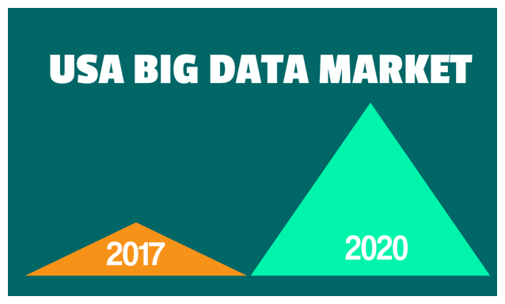

FUTURE OF BIG DATA
Data volumes will continue to grow
Ways to analyze data will improve
More tools for analysis (without the analyst) will emerge
According to estimations the volume of data growing by 40% every year
By 2020 it will grow up to 45%.

